Slide 1


The EV Futures
Brian Matsiko

Slide 2






EU and California recently rolled out plans to phase internal combustion cars by 2035.
Currently there are four publicly traded fully electric vehicle manufacturing companies.
Business Problem
Goal of this project is to analyze the current stock and forecast futures of the four companies.
Evaluate whether the greater world are onboard with the new future of only electric vehicles
2

Slide 3


Data Overview
Source
Background
Stocking trading information was sourced from the yahoo API.
Entire trading history was included in this project.
TSLA is the only company based in North America and the other three companies are based out of China.
TSLA has been trading for 12 years
NIO has traded for 3 years
Both LI and XPEV have only been trading for a year
3

Slide 4


Exploratory Data Analysis

Slide 5

Feature Correlations With Price Close
TSLA
LI
Correlation of Close
Correlation of Close
Correlation of Close
NIO
XPEV
Correlation of Close
Correlation of Close

Slide 6

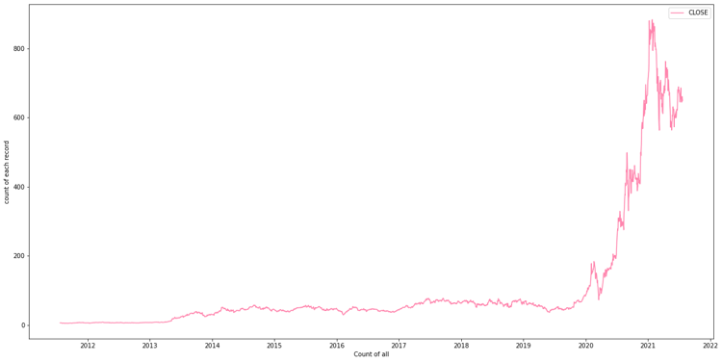
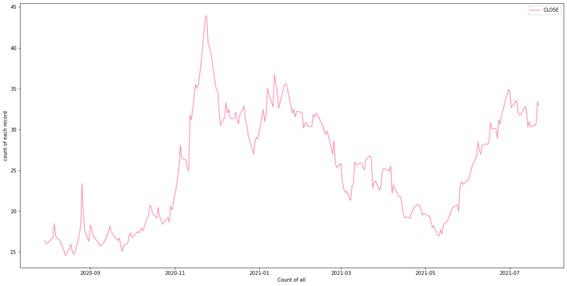
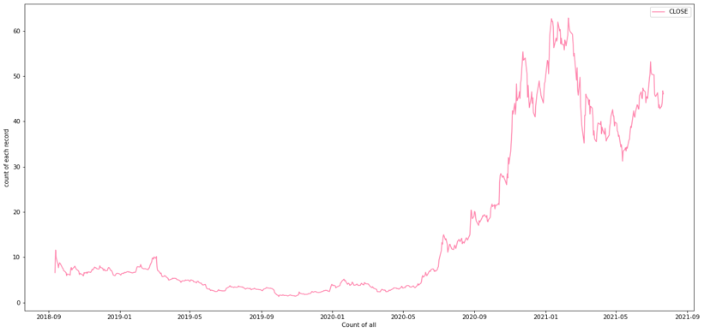
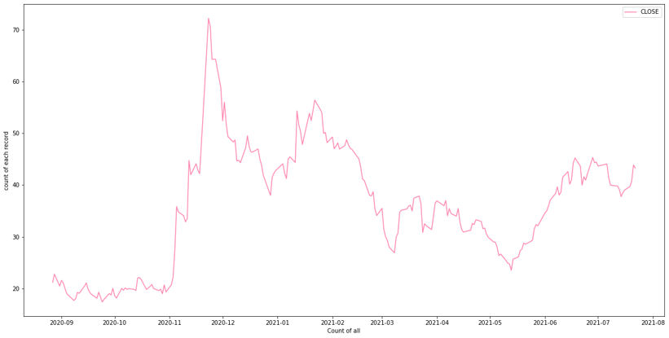
Stock Trading Trends
TSLA
LI
NIO
XPEV
6

Slide 7
Machine Learning Process

Slide 8






Target And Features
Modelling
Models
Target
Baseline LSMT model
Facebook Prophet, ARIMA and SARIMA models
Daily Stock Closing prices
Process Overview
Features and Transformations
Evaluation metrics
Mean Absolute Error (MAE)
Mean Squared Error (MSE)
Mean Percentage Absolute Error (MAPE)
Open, low, high, volume
Normalized
Data time series split into train and test -70% to 30%

Slide 9
First Simple Models With LSMT

Slide 10

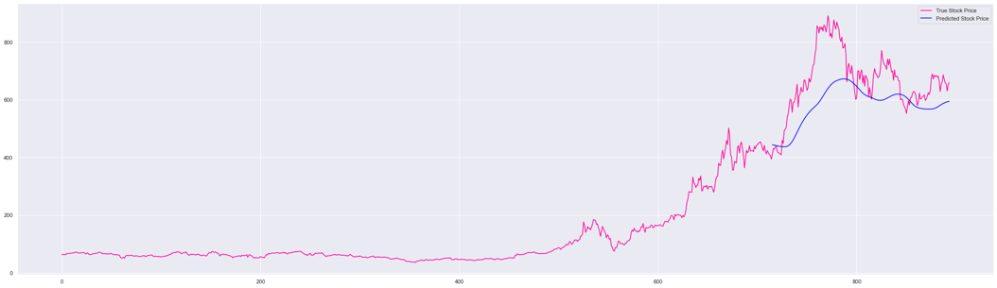

TSLA
Mean Absolute Error - $91.2

Slide 11
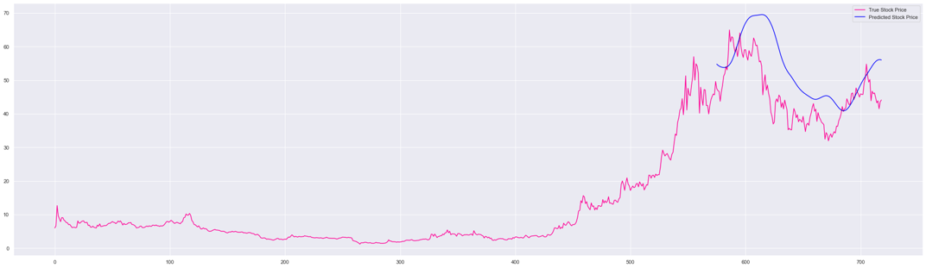
NIO
Mean Absolute Error - $8.65

Slide 12
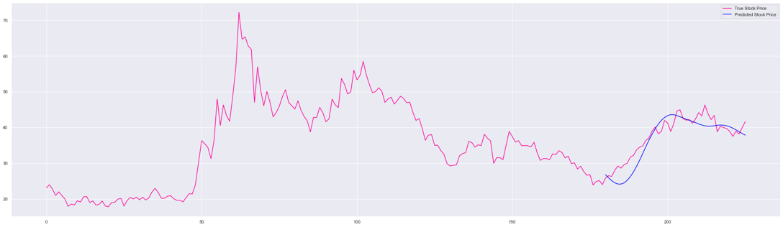
XPEV
Mean Absolute Error - $2.27

Slide 13
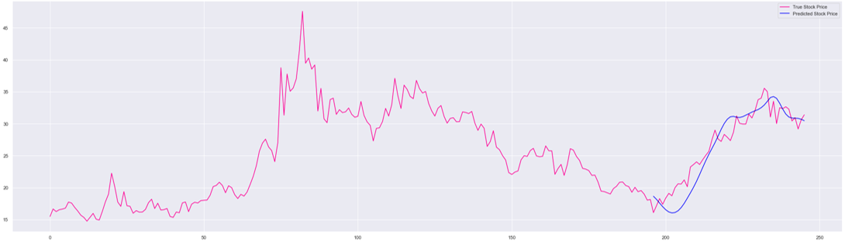
LI
Mean Absolute Error - $1.72

Slide 14
FB Prophet Models

Slide 15

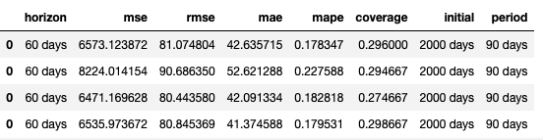

FB Prophet Sam
Overall the second-best evaluation metrics
Sample Metrics represent the model on TSLA stock
15

Slide 16
Final Model

Slide 17
SARIMA
Overall Had the best evaluation metrics
MSE
MAE
Sample Metrics represent the model on TSLA stock
17

Slide 18
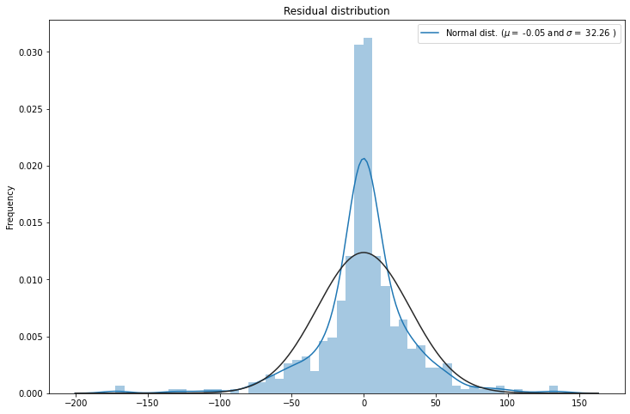
SARIMA Residual plot
No patterns observed on fitted model
Sample Metrics represent the model on TSLA stock
18

Slide 19
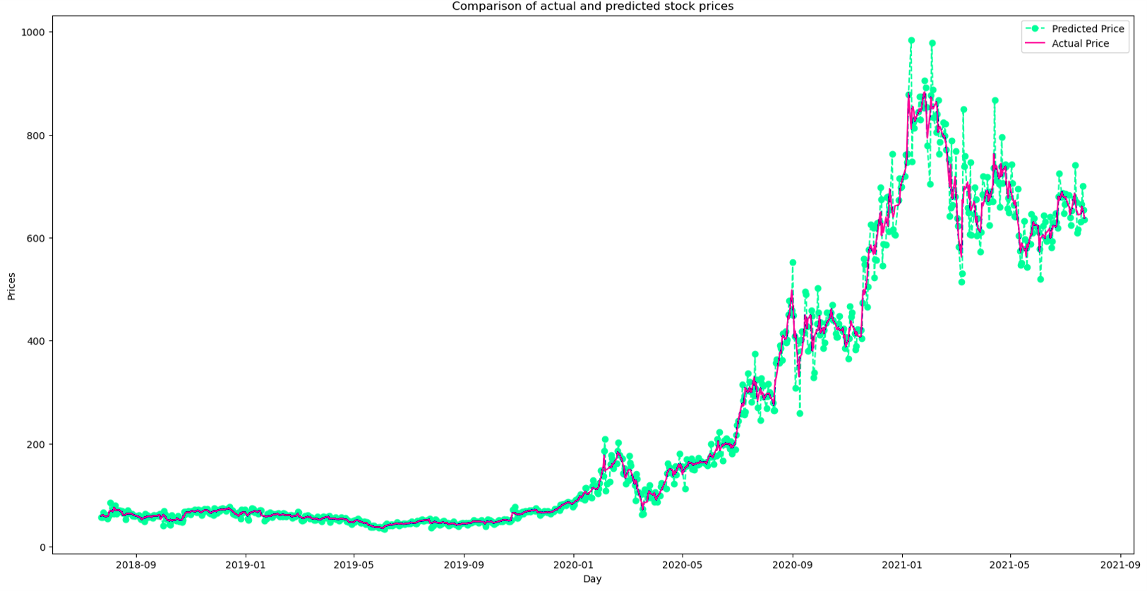
SARIMA TSLA Actual Vs Predicted Stock Prices
MAE – $7.88

Slide 20
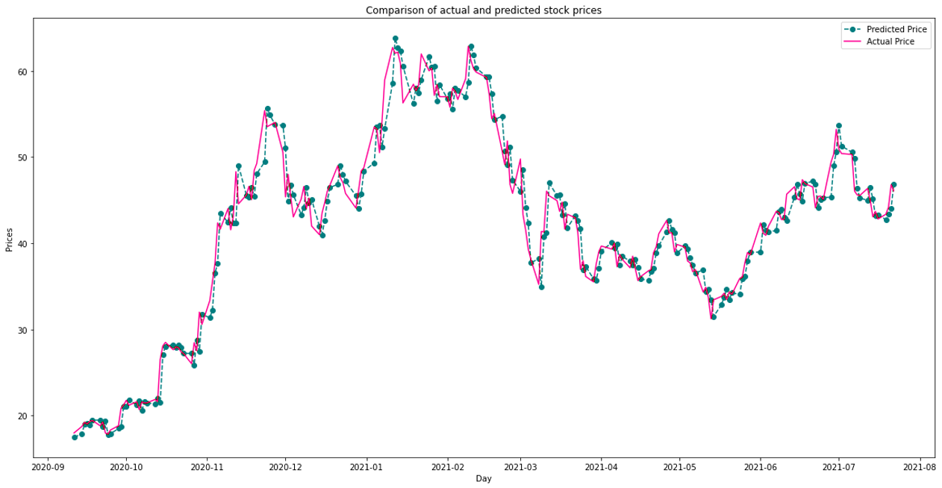
SARIMA NIO Actual Vs Predicted Stock Prices
MAE – $1.60

Slide 21
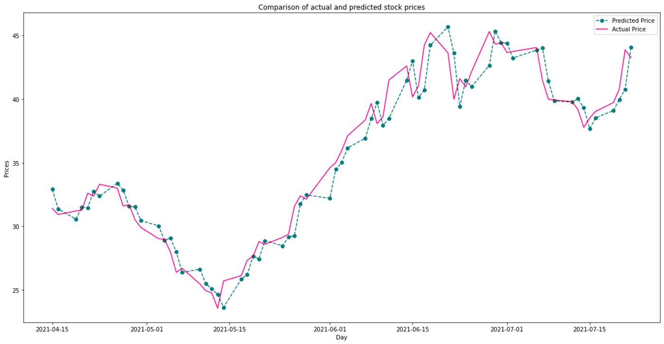
SARIMA XPEV Actual Vs Predicted Stock Prices
MAE – $1.99

Slide 22
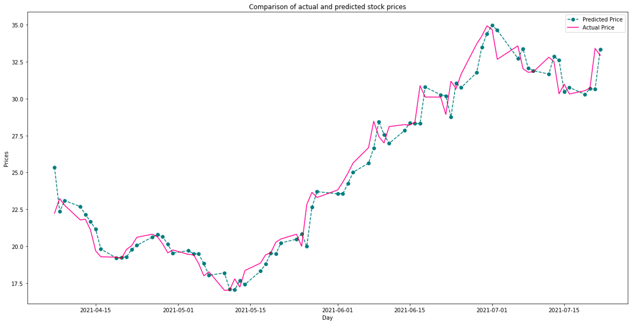
SARIMA LI Actual Vs Predicted Stock Prices
MAE – $0.97

Slide 23
Forecasts

Slide 24
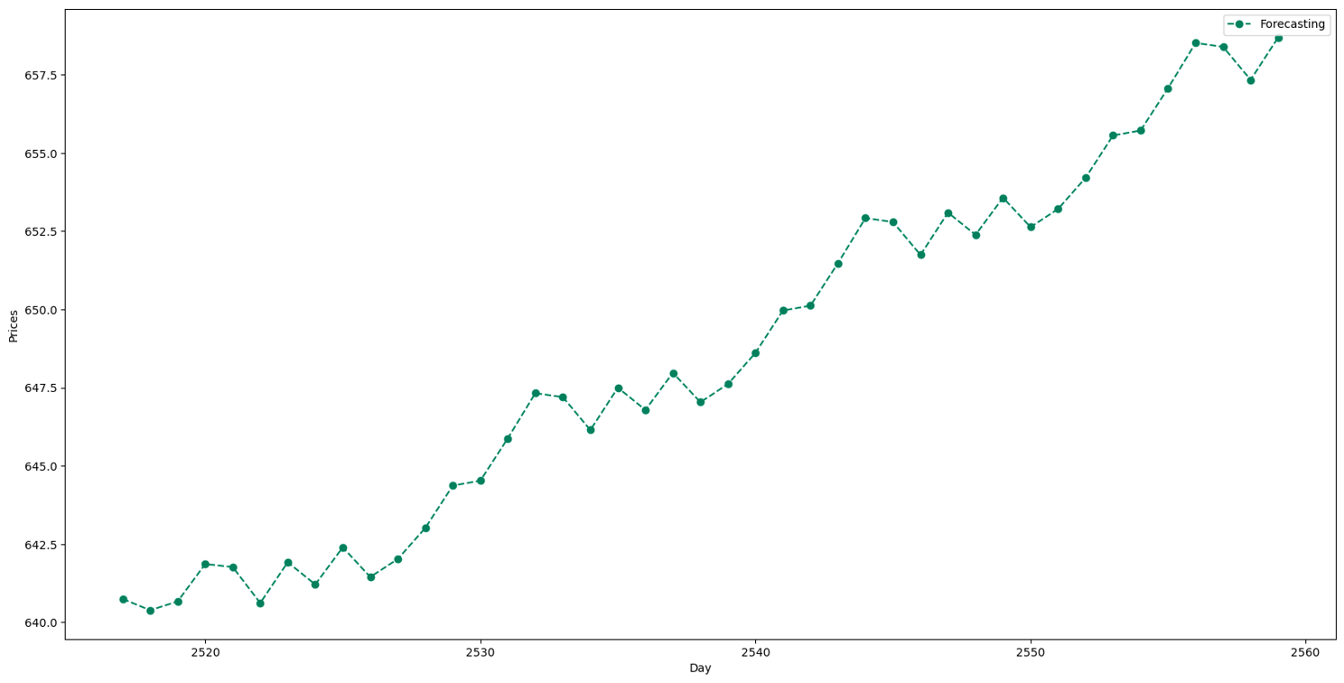
TSLA 42 DAY STOCK FORECAST

Slide 25
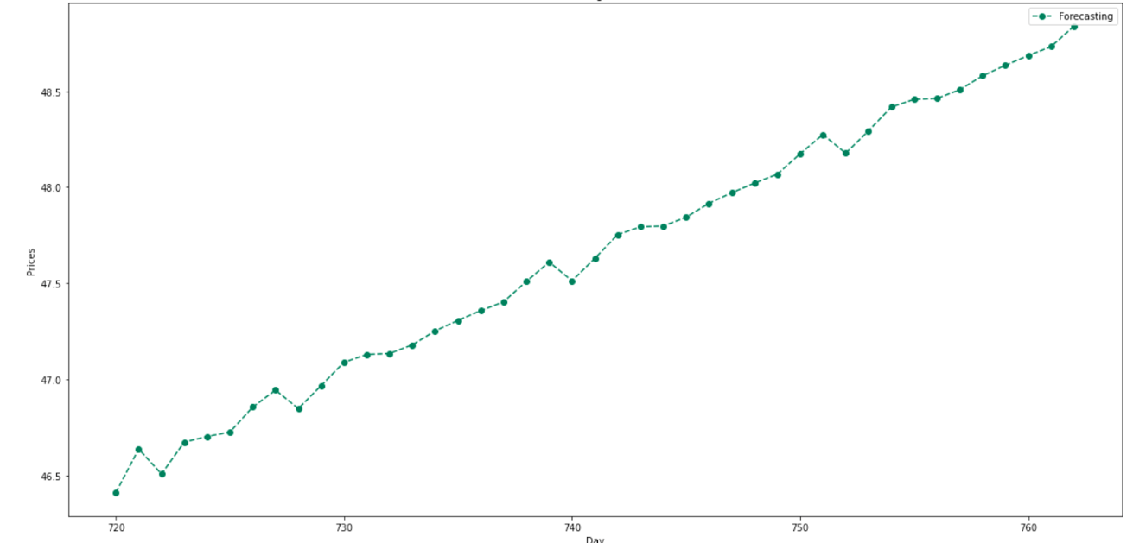
NIO 42 DAY STOCK FORECAST

Slide 26
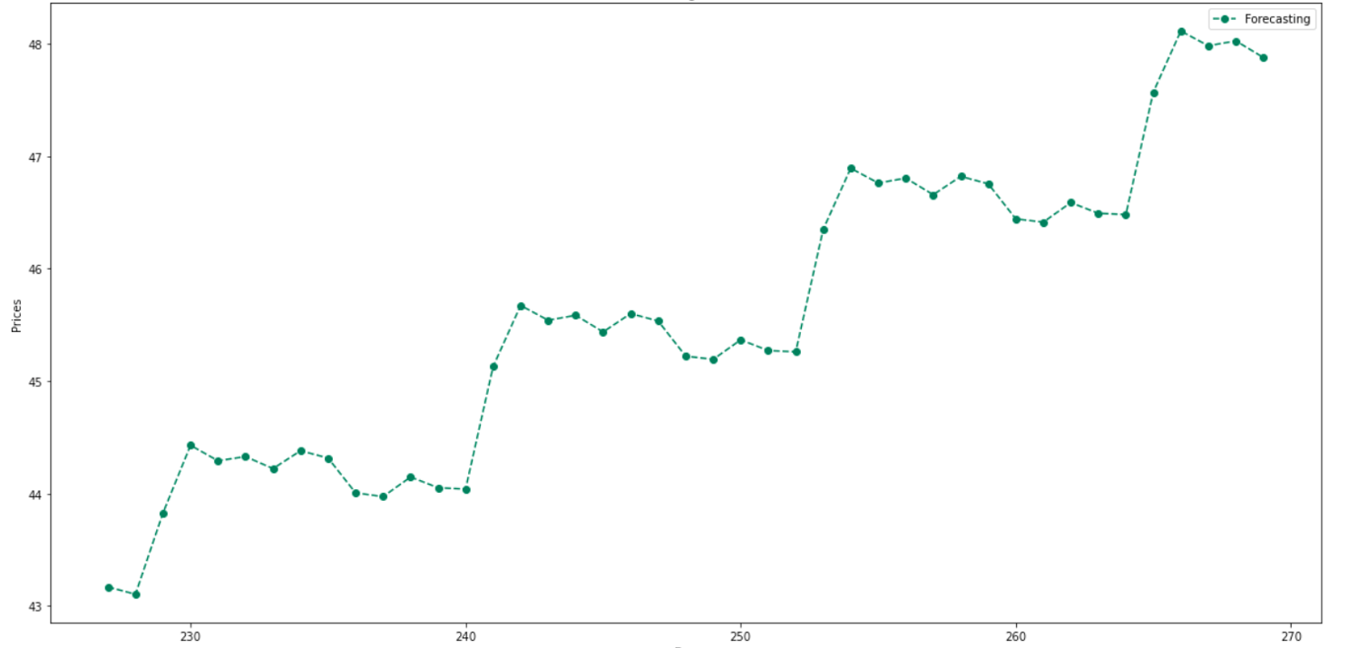
XPEV 42 DAY STOCK FORECAST

Slide 27
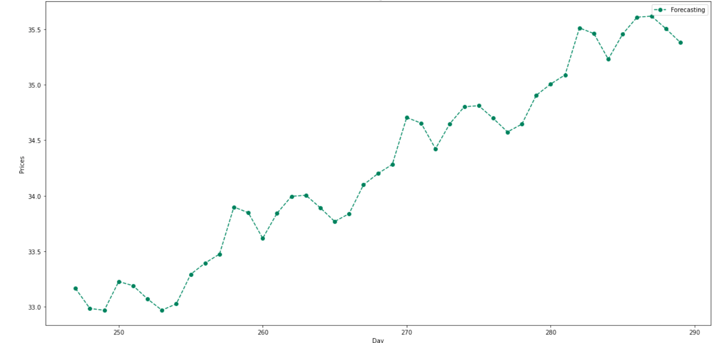
LI 42 DAY STOCK FORECAST

Slide 28
Conclusions

Slide 29







Key Results & Deductions
All EV Stocks are forecasted to be trending higher
General Automotive market trend not included
Previous Short-term trend was currently up for all the EV stocks as well
General Stock market trend not included
Indication of short-term interest in all these stocks

Slide 30

Next Steps
General Market & Industry Inclusion
Stock trading Volume analysis
Publishing all inclusive results

Slide 31



Thank You
Brian Matsiko
Contact Number
matsikobrian@yahoo.com

